Slide 1

WELCOME TO ADOBE CREATIVE CLOUD
WELCOME TO ADOBE CREATIVE CLOUD
WELCOME TO ADOBE CREATIVE CLOUD

Slide 2
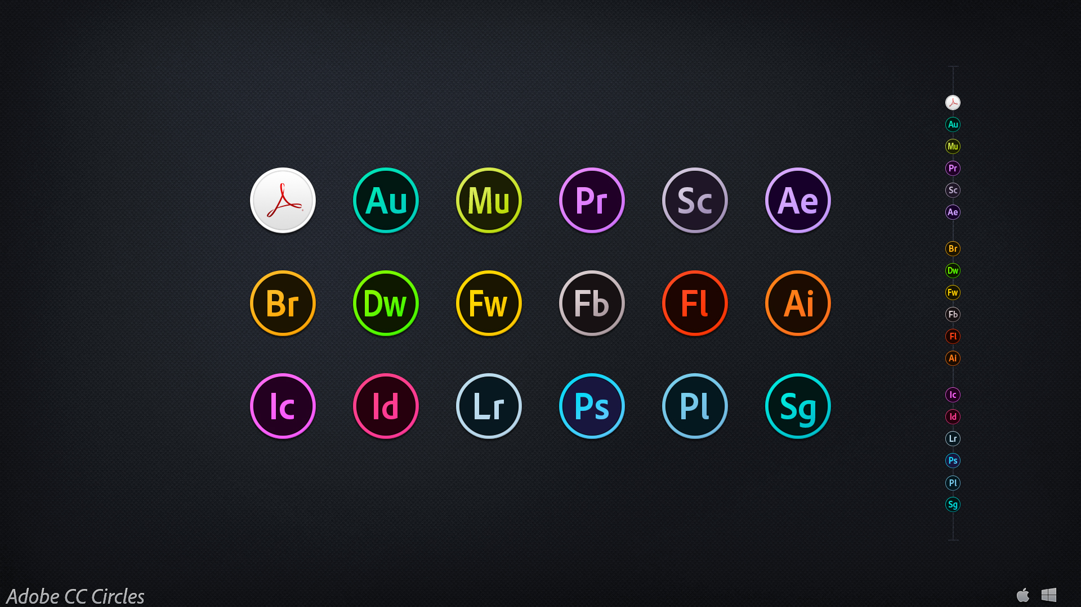
FEATURES:
This Photo by Unknown Author is licensed under CC BY-ND

Slide 3
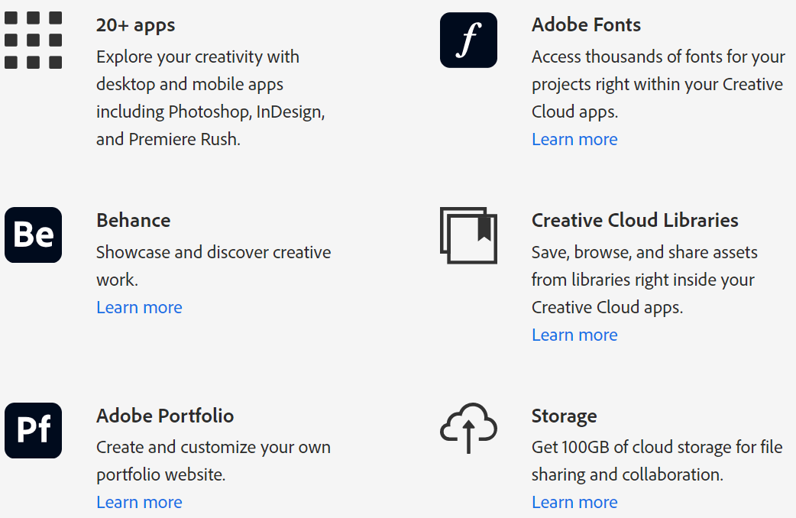
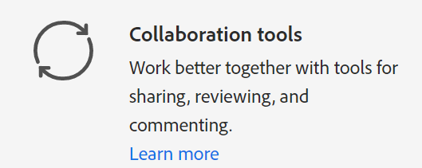
FEATURES:

Slide 4
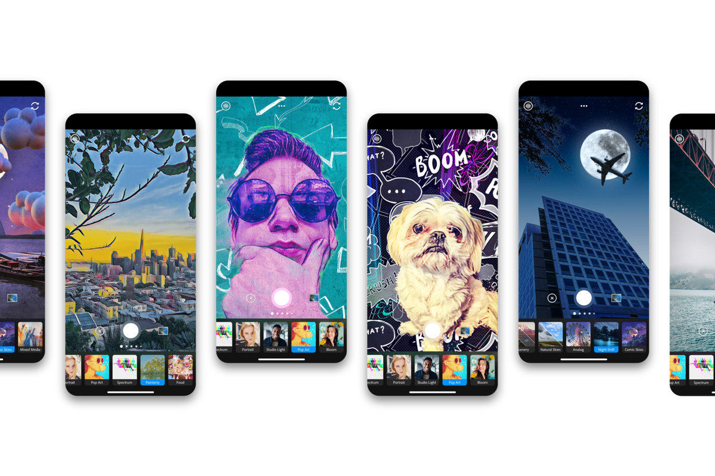
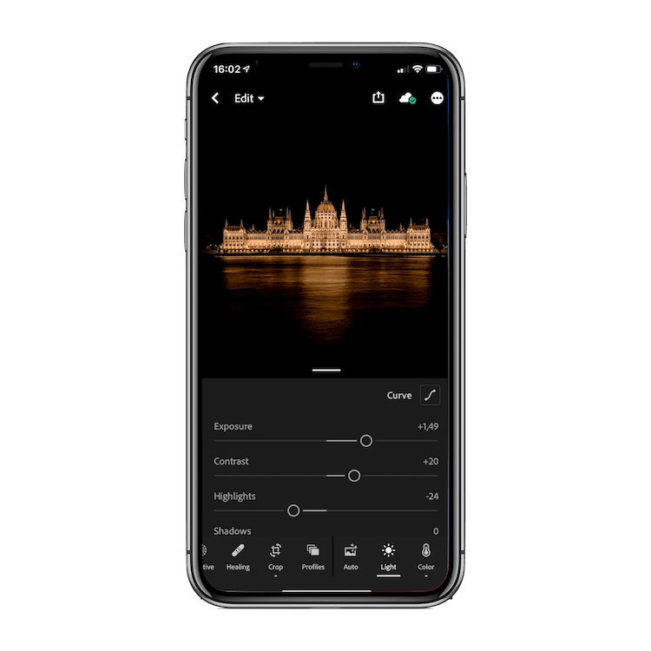
NOW AVAILABLE ON IPHONE

Slide 5
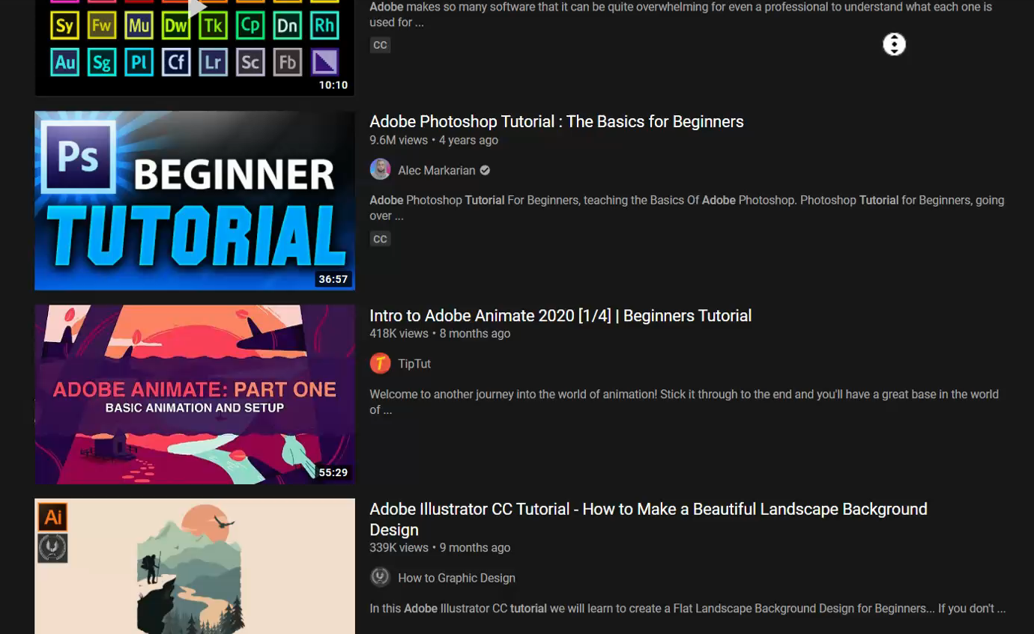
https://www.youtube.com/results?search_query=adobe+tutorials

Slide 6
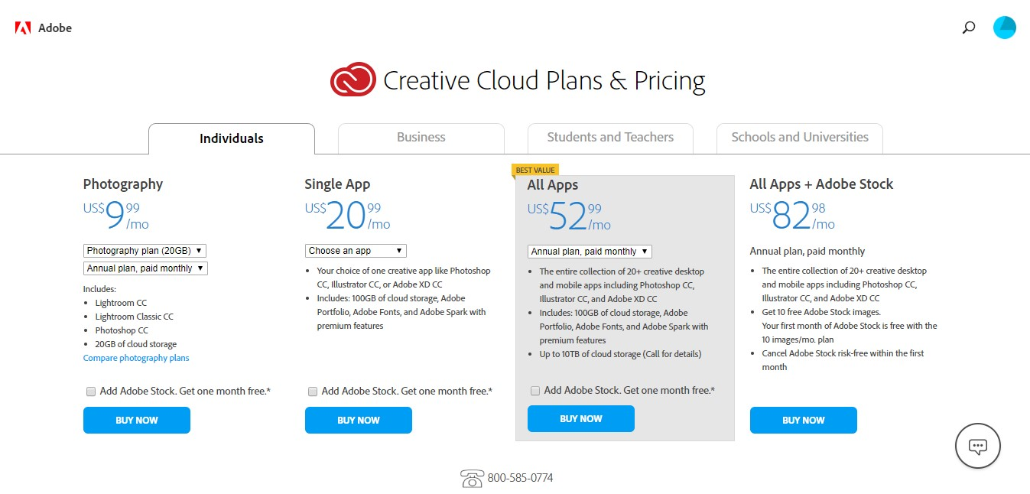
https://www.adobe.com/creativecloud/plans.html

Slide 7

https://www.adobe.com/creativecloud.html?sdid=KKSPR&mv=search&s_kwcid=AL!3085!10!78752647940651!78752917269812&ef_id=04d2de78ea7811328a8a81e96095f332:G:s

Slide 8
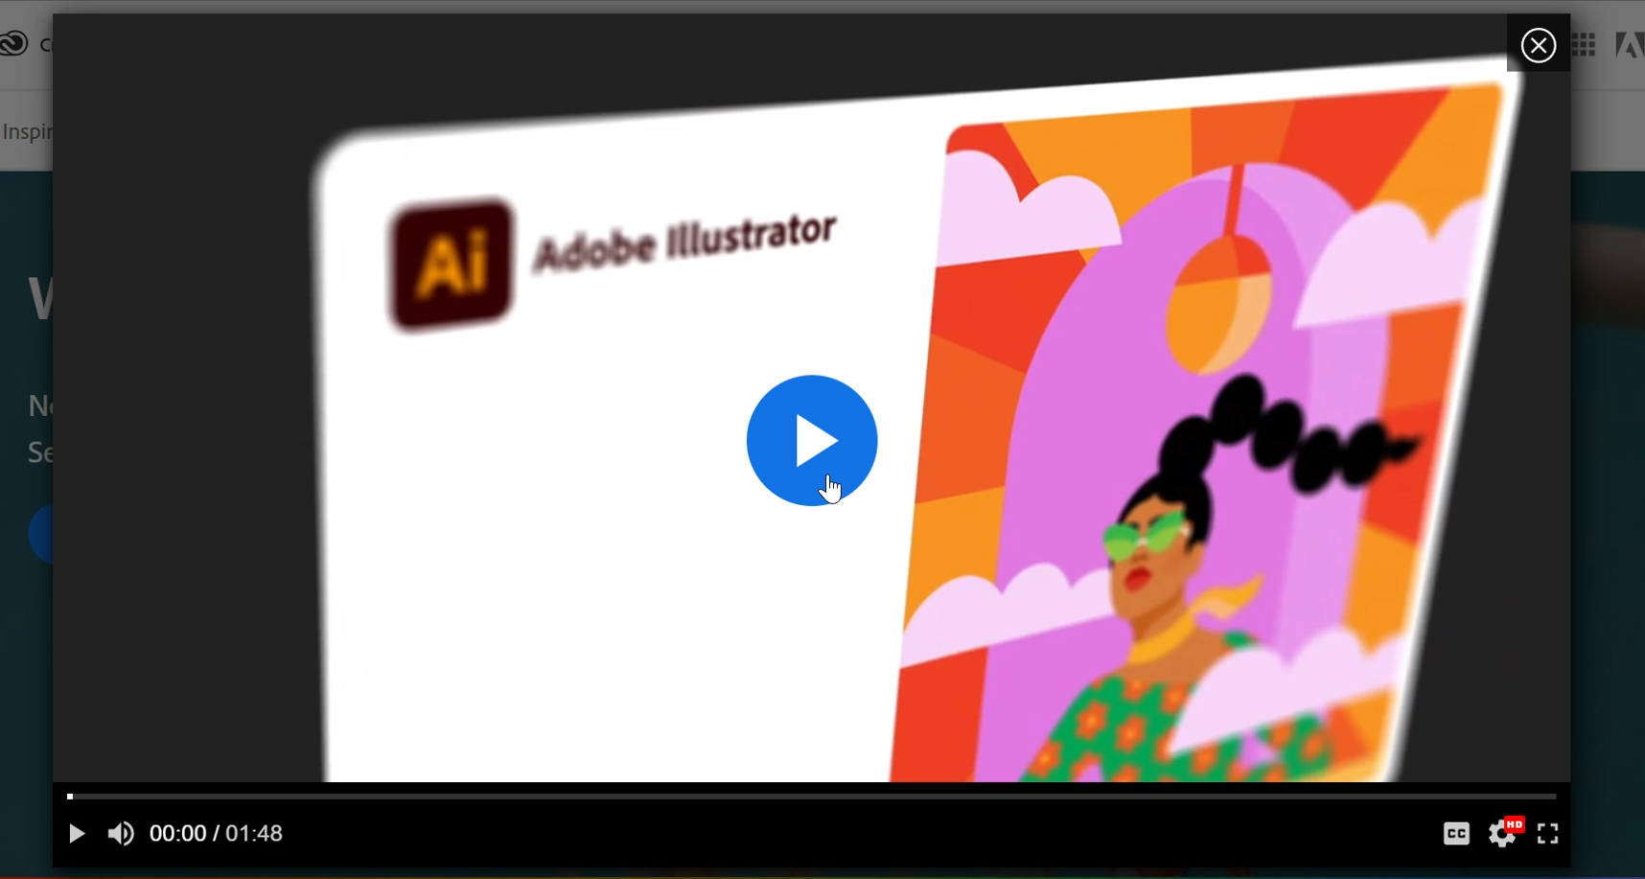
https://creativecloud.adobe.com/cc/en/discover/article/whats-new

Slide 9

https://www.apple.com/apple-pencil/?afid=p238%7CsraIMFAgF-dc_mtid_1870765e38482_pcrid_378126887195_pgrid_76054337646_&cid=aos-us-kwgo---slid---product-

Slide 10
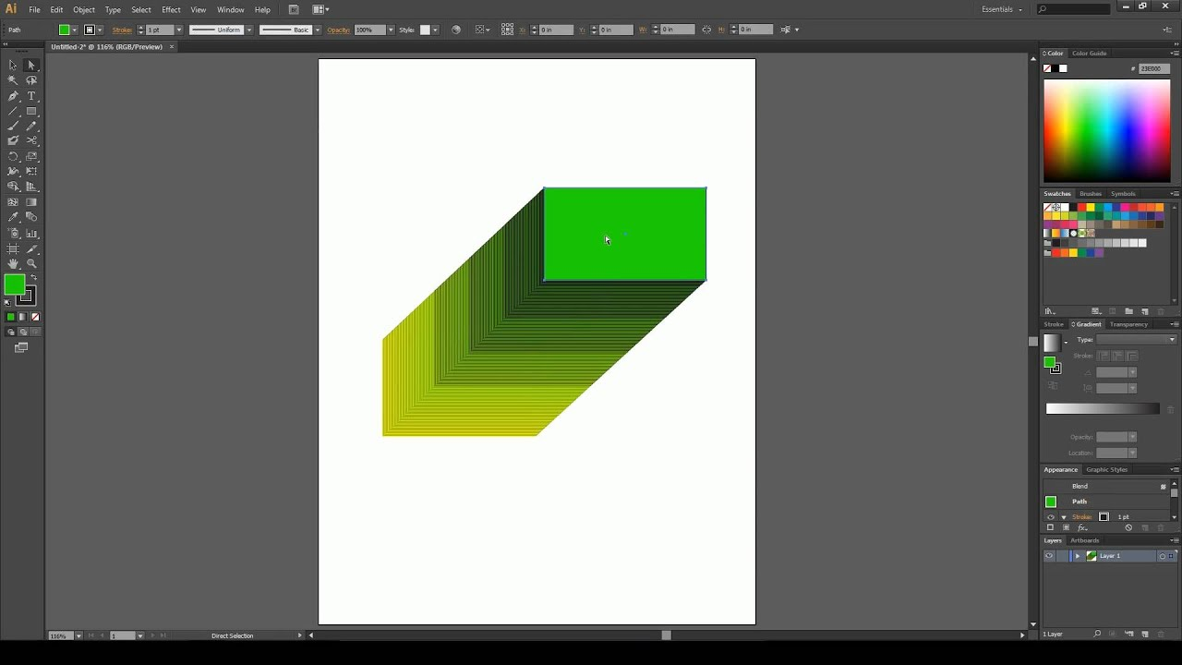





Where will your imagination take You?
Where will your imagination take You?

